Slide 1
Understanding Customer Churn: Data-Driven Insights for Retention
Uncovering Key Factors Behind Churn and Strategies for Customer Retention

Slide 2
Contents
Introduction
Dataset Overview
Data Preparation and Cleaning
Key Analysis
Insights From Analysis
Recommendations
Conclusion

Slide 3
Introduction
Customer churn is a critical challenge for businesses, especially in the banking sector, where retaining customers is more cost-effective than acquiring new ones.
This analysis explores key factors that contribute to customer churn using a dataset of bank customers, focusing on attributes such as credit score, tenure, account balance, number of products, and customer activity.
By identifying trends and patterns, this study aims to provide actionable insights to help businesses improve customer retention strategies, enhance engagement, and minimize revenue loss.
Through data visualization, we uncover the most influential factors behind churn and recommend targeted interventions to reduce it.

Slide 4
2. Dataset Overview
The dataset used for this analysis contains information on 10,000 bank customers, with details on their demographics, account characteristics, and activity status. The key attributes analyzed include:
Customer Information:
Credit Score – Measures the creditworthiness of customers.
Geography – The country where the customer is located.
Gender – Identifies whether the customer is male or female.
Age – Helps understand churn trends across different age groups.
Account & Activity Details:
Tenure – Number of years the customer has been with the bank.
Balance – The amount of money held in their account.
Number of Products – The number of financial products the customer holds.
Has Credit Card – Indicates whether the customer has a credit card.
Is Active Member – Whether the customer actively engages with the bank.
Target Variable:
Churn Status – Indicates whether the customer has left the bank.

Slide 5
3. Data Preparation and Cleaning
To ensure the dataset was accurate and ready for analysis, I performed several data cleaning steps using Microsoft Excel.
First, I checked for missing values and found that all fields were complete, eliminating the need for imputation.
Next, I removed duplicate records to prevent skewed insights. I also standardized categorical values, ensuring consistency in fields like Geography and Gender. For numerical features such as Credit Score, Age, and Balance, I reviewed outliers using conditional formatting and filtered extreme values that could distort trends.
Finally, I created new calculated fields where needed, such as segmenting age groups to analyze churn patterns across different demographics. These steps ensured a clean and structured dataset for accurate visualization and analysis.

Slide 6
4. Key Analysis
Our analysis revealed several important insights about customer churn trends. Customers aged 50-60 were found to be more likely to churn, suggesting that this age group may face unique challenges or dissatisfaction with the bank’s services. This could be due to shifting financial priorities or the search for more competitive options.
Additionally, tenure and account activity emerged as key indicators of retention, with customers who had a shorter tenure and lower engagement showing significantly higher churn rates.
Surprisingly, customers with multiple products had a higher churn rate, indicating potential dissatisfaction, product misalignment, or aggressive upselling.
Geographic trends also varied, with certain regions experiencing higher churn. These findings highlight the need for targeted retention strategies, especially for the 50-60 age group, focusing on personalized engagement and better-aligned product offerings to reduce churn.

Slide 7
5. Insights From Analysis
Geographic Impact: Germany exhibited the highest churn rate at 32%, indicating that regional factors might influence customer retention.
Tenure and Churn: Customers with 0-1 years of tenure had the highest churn rate at 22.58%, suggesting that newer customers are more likely to leave, possibly due to unmet expectations or insufficient engagement.
Age Influence: The 50-60 age group experienced the highest churn at 56%, highlighting a potential issue with retention strategies for older customers.
Credit Score Impact: Customers with a poor credit score had a 22% churn rate, which may suggest financial stability plays a role in long-term engagement.
Gender and Churn: Females had a 25% churn rate, which could indicate differing customer experiences or product preferences between genders.
Product Ownership and Churn: While customers with 3+ products had a significantly high churn rate, the sample size for these groups is significantly smaller than others. This suggests a potential trend where higher product adoption correlates with increased churn, but further analysis is needed to determine if this is due to dissatisfaction, over-selling, or other factors.

Slide 8
6. Recommendations
Improve Early Customer Engagement: Since 0-1 year tenure customers had the highest churn (22.58%), implementing targeted onboarding programs, personalized support, and loyalty incentives could help improve retention.
Address High Churn in Germany: With Germany having the highest churn rate (32%), further investigation into regional factors, such as banking policies, customer preferences, or service issues, could help tailor retention strategies.
Reevaluate Product Offerings and Upselling Strategies: Customers with 3+ products exhibited extremely high churn rates, suggesting potential dissatisfaction or over-selling. Conducting surveys and analyzing customer feedback could help refine product bundling and cross-selling approaches.
Enhance Retention Efforts for Older Customers: The 50-60 age group had the highest churn (56%), indicating a need for age-specific engagement strategies, such as improved communication, tailored financial products, or personalized outreach.

Slide 9
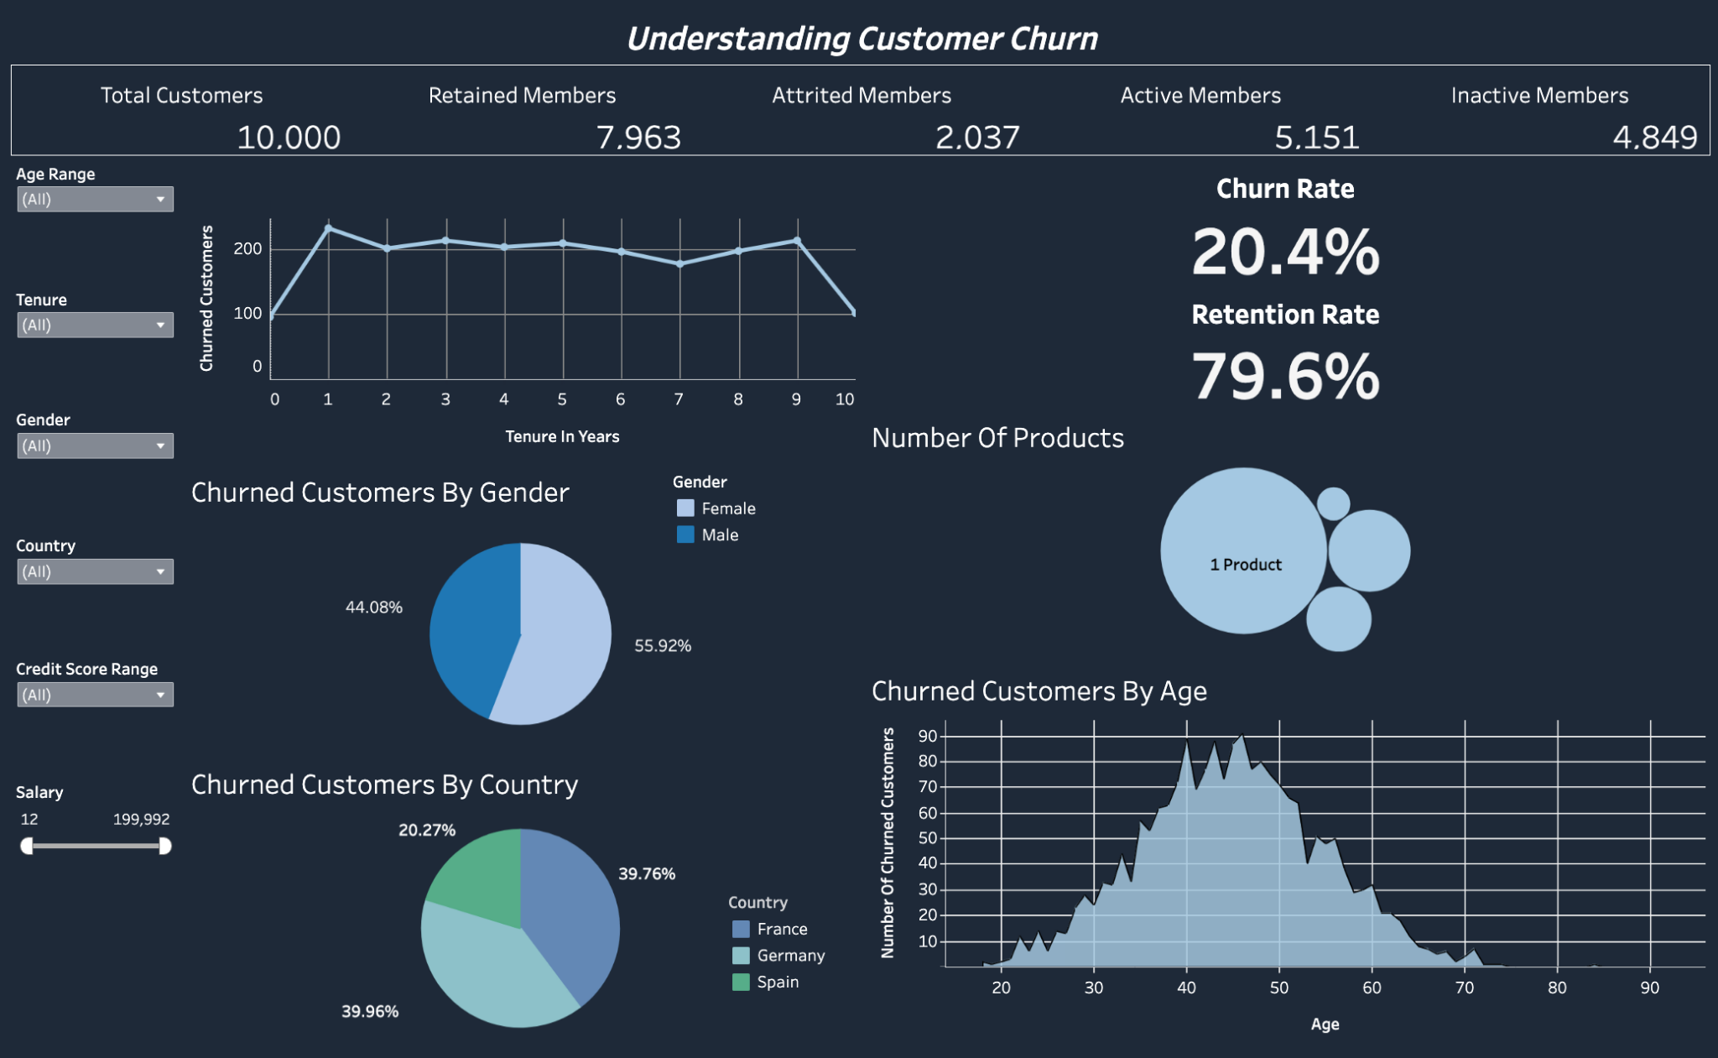
7. Conclusion
This customer churn analysis provides valuable insights into factors driving customer attrition, helping to identify opportunities for improving retention strategies and optimizing customer engagement. I created a dashboard using Tableau to further explore these patterns, visualizing key trends such as churn by tenure, geography, product ownership, and customer demographics.
Link can be found here: https://public.tableau.com/app/profile/tyler.valdez/viz/CustomerChurnAnalysis_17390989836820/Dashboard1

